Slide 1

MAHARASHTRA STATE BOARD OF TECHNICAL EDUCATION
GOVERN POLYTECHNIC, JINTUR
Course : | CO-6K | Academic Year : | 2025-26
Project Title : | Smart Expense Tracker System
Project Guide : | Mr. M.A.Zahed
SR. NO. | NAME | ROLL NO.
1 | AMRAPALI GOVIND ADHAV | 304
2 | SHRUTI RAJKUMAR GAIKWAD | 316
3 | NANDINI TUKARAM JADHAV | 320
4 | ANJALI HANUMAN SATPUTE | 341

Slide 2


🎯Background
In modern life, managing daily expenses has become difficult due to increasing transactions and complex financial activities, while traditional methods like manual records are time-consuming and error-prone. Therefore, a smart and user-friendly digital solution is needed to simplify expense tracking and improve financial planning, which is achieved through the Smart Expense Tracker System.
Definition
Objectives
The Smart Expense Tracker System is an application used to manage and track daily expenses. It helps users categorize spending, set budgets, and get insights into financial habits. It improves financial planning and reduces manual effort.
To develop a simple and user-friendly application for tracking, categorizing expenses, and managing budgets with real-time insights.
To ensure secure, accessible financial management while helping users analyze data and achieve their financial goals.

Slide 3

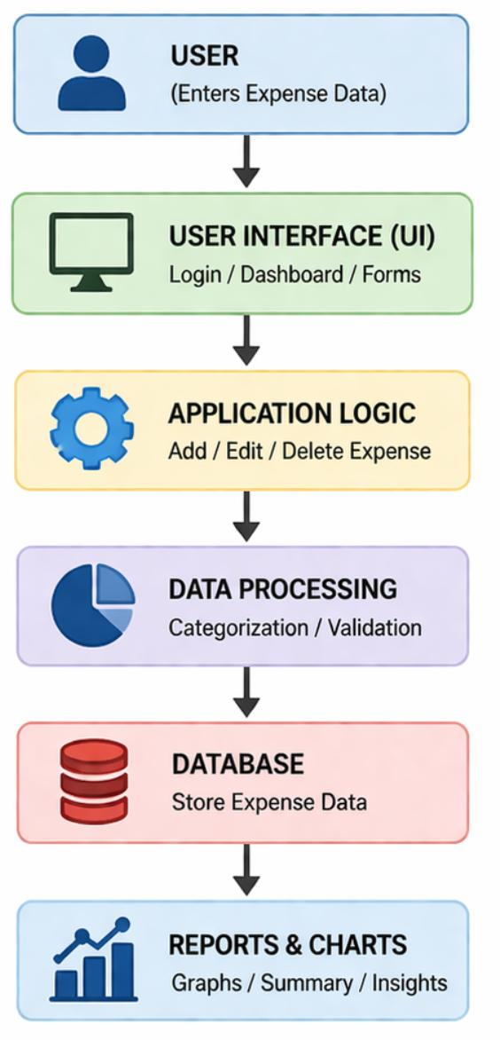
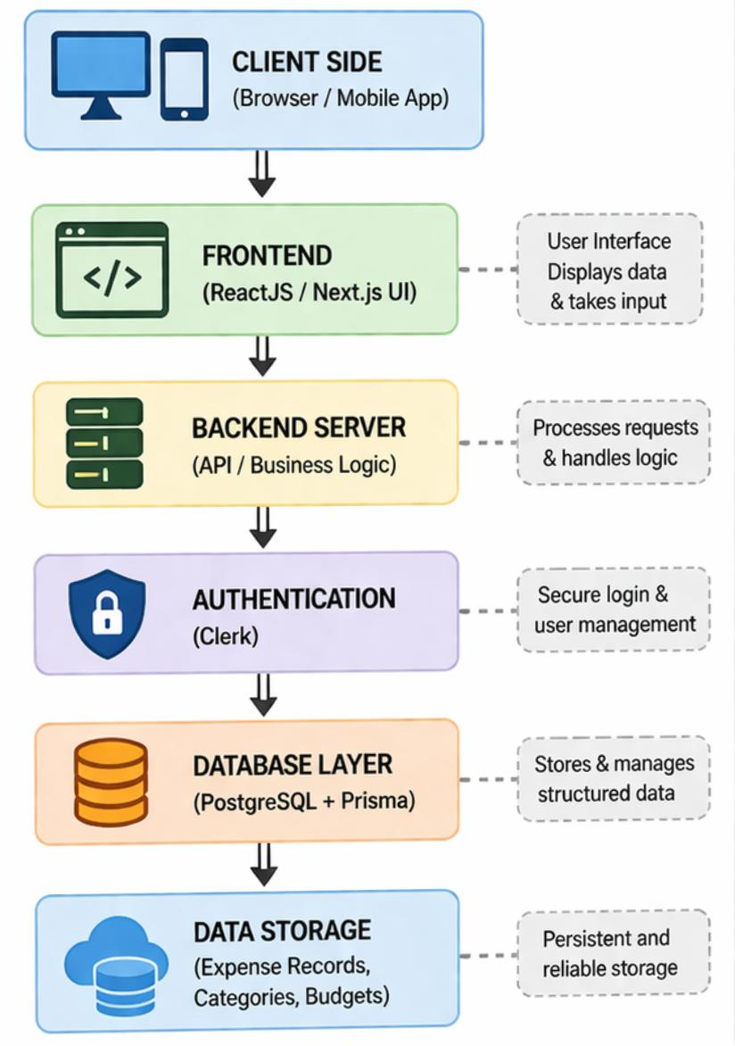
Design and architecture
System Design
System Architecture
This diagram explains how the system works step by step. First, the user enters data, then the system processes and stores it, and finally shows reports for better understanding.
This diagram shows how the system is built. The user interacts with the frontend, the backend processes data, and the database stores it securely.

Slide 4
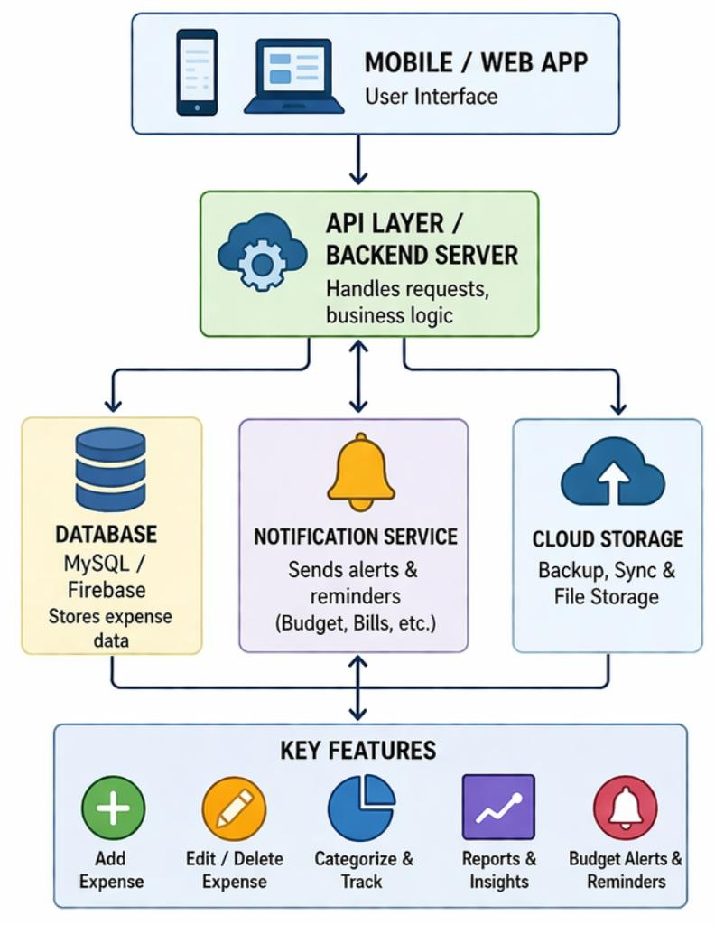
Smart Expense Tracker System
User Interface User enters and views expense data through mobile or web app.
Processing System Backend processes the expense details and manages operations.
Database Storage All expense records are stored securely in the database.
Reports & Notifications
System generates reports and sends alerts for better expense management.

Slide 5
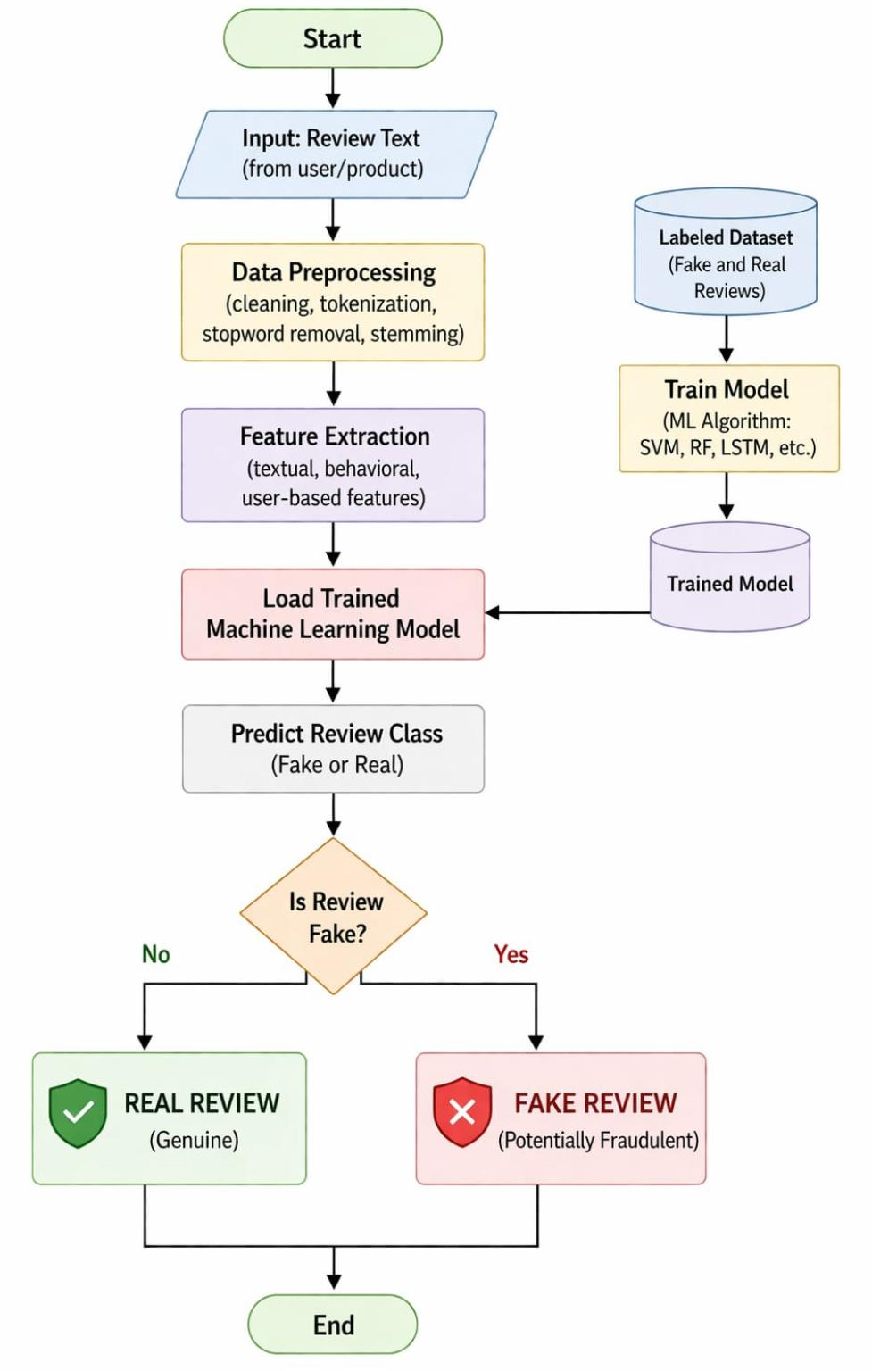
Working of flowchart
📌 Login Instructions
Open the College Portal website.
Input Review Text: The system takes a review from the user or product as input. Data Preprocessing: The text is cleaned by removing unnecessary words, symbols, and converting it into a useful format. Feature Extraction: Important features (like keywords, patterns, user behavior) are extracted from the review. Model Training & Loading: A machine learning model is trained using a dataset of real and fake reviews, then loaded for use. Prediction: The system analyzes the review and predicts whether it is fake or real. Final Decision: If the review is fake → marked as Fake Review If not → marked as Real Review
Click on the Login tab.
Enter your registered Email Address.
Enter your Password.
Click on the Sign In button.
If credentials are correct, you will be redirected to your dashboard (Student/Teacher).
✅ Login process completed.

Slide 6

The Dashboard shows a summary of financial data. It displays total income, expenses, savings, and charts for analysis. Helps users quickly understand their financial status.
Browse
My Uploads
New Upload
Dashboard
HOME PAGE
Budget Page
The Budget Page allows users to set spending limits for different categories. Users can track whether they are within their budget. Helps in controlling unnecessary expenses.
Expense Page
The Expense Page is used to add and manage daily expenses. Users can enter details like amount, category, and date. Helps in maintaining a record of all transactions.
Upload Resources

Slide 7
Total Budget shows the total amount of money planned for spending. It helps users manage and control their expenses within a limit.
Dashboard
Total budget: ₹0
Total Expense: ₹0
Total Expense shows the total amount of money already spent. It helps users track their spending and avoid overspending.
Back
The Back button is used to return to the previous page (Home Page). It helps in easy navigation within the system.

Slide 8
The Create Budget option is used to set a new budget limit. Users can define how much money they want to spend in a specific category or period.
Budget Page
Create budget
The Edit Budget option allows users to modify an existing budget. It helps in updating the budget based on changing financial needs.
Profile: Computer Year 1 Sem 1
Edit budget
TOTAL
12
SYLLABUS
7
LAB MANUALS
5
TEXTBOOK
0
ASSIGNMENT
0
PYQS
0
MICROPROJECTS
0
The Delete Budget option is used to remove an existing budget. It helps users manage and clear unnecessary or old budget entries.
Delete budget
Back
The Back button returns the user to the previous page (Home Page). It helps in easy navigation within the system.

Slide 9



Future Scope
Future Updates
Centralized platform for managing and sharing academic resources
Multi-user (family/group) expense tracking
Cloud storage for anytime access
Bank account integration for auto tracking Voice input feature for adding expenses
Role-based authentication for secure access (students & teachers)
Easy upload, access, and organization of study materials
AI-based expense prediction and suggestions
Advanced data analytics and insights
Personalized alerts and reminders Multi-currency support
Advanced features: search, filtering, bookmarking, and notifications
Trending resources to highlight popular study content
References
Uses data analysis and reporting tools
Uses database management systems (DBMS)
Built using modern technologies: Node.js, Express.js, MongoDB, React (Vite)
Cloud integration (Cloudinary, Render, Vercel) for accessibility and storage
Based on mobile application technology
Inspired by real-world finance apps
Improves learning efficiency and replaces traditional unorganized methods

Slide 10

Conclusion
Helps users easily record and organize their daily expenses.
Assists in setting budgets and controlling unnecessary spending.
Generates useful insights through charts and summaries.
Automates calculations and reduces manual record keeping.
Expenses are updated instantly, improving financial awareness.
Designed with a simple interface for easy access and usage.
Ensures safety and proper organization of financial data.
Helps users make informed financial decisions using insights and reports.
Thank You

